Slide 1

Development of website for a Training Organization
Module Project
Module: Application Development Capstone
Start Date : 24-09-2024
End Date : 27-11-2024
Submission Date : 24-11-2024
Learner Name : Wong Park Kit, Tan Ee Fun, Khoo Kah Heng
Enrollment ID : DSE211/03 Application Development Capstone
Presentation Date : 24-11-2024

Slide 2
Introduction

Slide 3
Project Name And Background
Project Name: Library Management System
Background: Libraries have customarily served as significant center points for learning and asset get to. Be that as it may, the quick pace of innovative headway has highlighted the wasteful aspects of conventional, manual library administration frameworks. These frameworks regularly battle with challenges such as wrong record-keeping, restricted openness to assets, and tall authoritative workloads. For understudies and staff, the need of an proficient look and borrowing handle can lead to disappointment and misplaced efficiency.

Slide 4
Project Objective
Project Objective: Develop a website for library.
The goal is to simplify and optimize the library management system
1.Enhancing Efficiency: Automate repetitive tasks such as book borrowing, returns, and overdue notifications, reducing manual workload and errors.
2.Improving Accessibility: Provide a digital platform accessible via web browsers, enabling users to search and reserve books from anywhere.
3.Streamlining Resource Management: Facilitate real-time tracking of book inventory and ensure accurate status updates for borrowed, reserved, or available items.

Slide 5
Project Scope
The project involves developing a library management system
1)User Account Management: Role-based user access, including students, library staff, and administrators.
2)Book Catalog: An interactive, searchable catalog with filters for title, author, genre, and availability status.
3)Transaction Automation: Features for borrowing, returning, and reserving books, supported by real-time updates and notifications.

Slide 6
System Architecture and Design

Slide 7
Technical Overview
To ensure the stability, security, and scalability of the system, the project adopts a variety of mainstream technologies. The key technologies used are:
Programming language: PHP is used in the backend to ensure system stability and scalability.
Front-end framework: HTML, JavaScript and Bootstrap are used in the front end to achieve dynamic interaction and responsive layout.
Database system: MySQL is selected to ensure data security and efficient access.
Development tools: VSCode is used to provide efficient development environment and plug-in support.

Slide 8




Technical Overview
Programming Language:
Backend: PHP
A widely-used server-side scripting language that's especially suited for web development. It allows you to create dynamic content and interact with databases.
Frontend Framework:
HTML, JavaScript, and Bootstrap
HTML: The backbone of our webpage, defining the structure of our content.
JavaScript: Adds interactivity and dynamic behavior to the user interface, such as form validation and interactive elements.
Bootstrap: A front-end framework that simplifies responsive web design and provides pre-styled components like modals, buttons, and navigation bars.

Slide 9

Technical Overview
Database System:
MySQL
An open-source relational database management system. It's known for its reliability and efficiency in handling large amounts of data.
Development Tools:
Visual Studio Code
A highly popular, free source-code editor developed by Microsoft. It includes support for debugging, embedded Git control, syntax highlighting, intelligent code completion.

Slide 10
System Architecture
The system consists of three main components:
Frontend Interface - The user interface that interacts with the users.
Backend Server - Handles business logic, data processing, and interactions with the database.
Database - Stores and manages data, such as user information, books listing and transactions.
Interaction Flow:
User Interaction: The user interacts with the frontend interface through a web browser.
Backend Processing: The backend processes the business logic, handling tasks such as user authentication, books auctions, and borrowing books.
Database Interaction: The backend communicates with the database to retrieve or store data as needed.
Result Display: The backend then sends the results back to the frontend, which displays the information to the user.

Slide 11
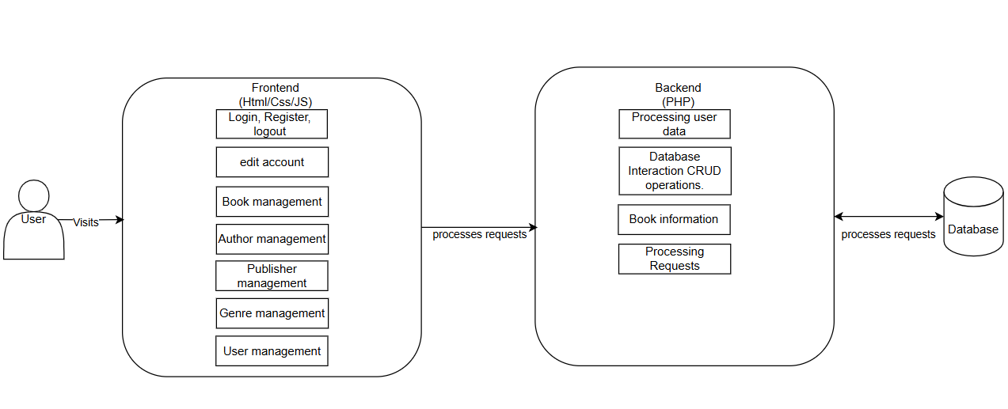
System Architecture Diagram

Slide 12
Database Design
Database Table Structure:
The main tables include:
books (Book Information)
authors (Author Information)
genres (Genre Information)
publishers (Publisher Information)
permission (Permission)
users (User Basic Information)
transcations (Borrowing Records)
Table Relationships:
books is linked to authors, genres, and publishers through foreign keys (AuthorID, GenreID, PublisherID).
transactions connects users and books to log borrowing activities.
users is linked to permission for authentication.

Slide 13
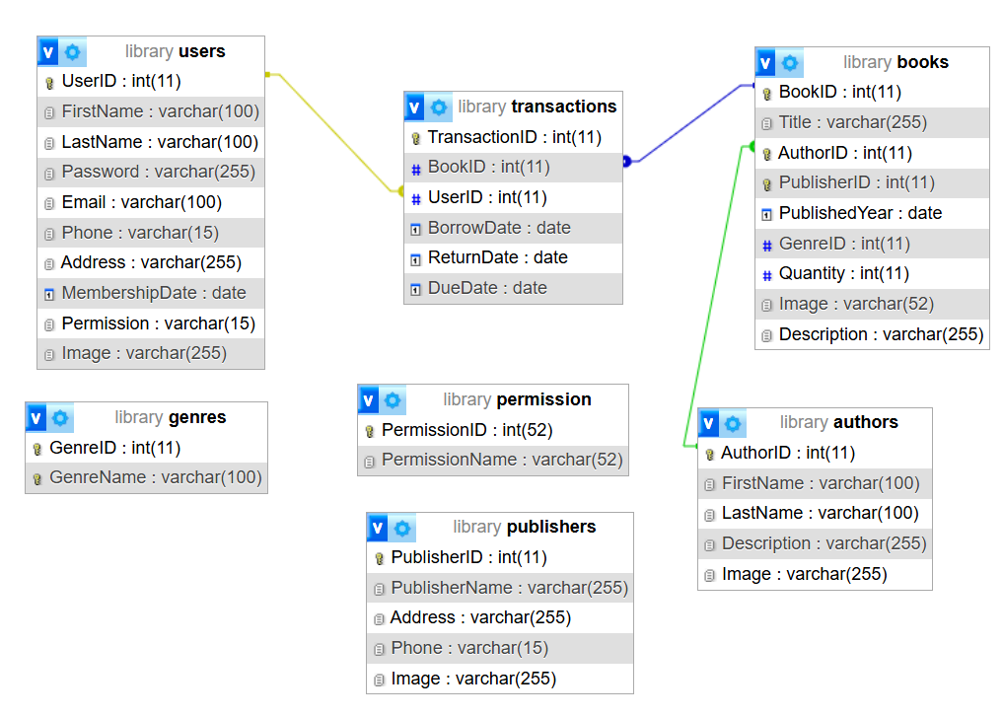
Database Design

Slide 14
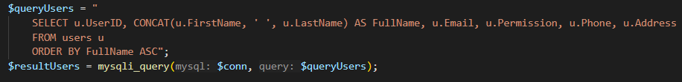
Key Code
1. Save User Data:
This involves storing user information into the users table
2. Retrieve User Data:
This retrieves a user's details from the users table based on their email or other unique identifiers.

Slide 15
Demonstration of Key Features

Slide 16
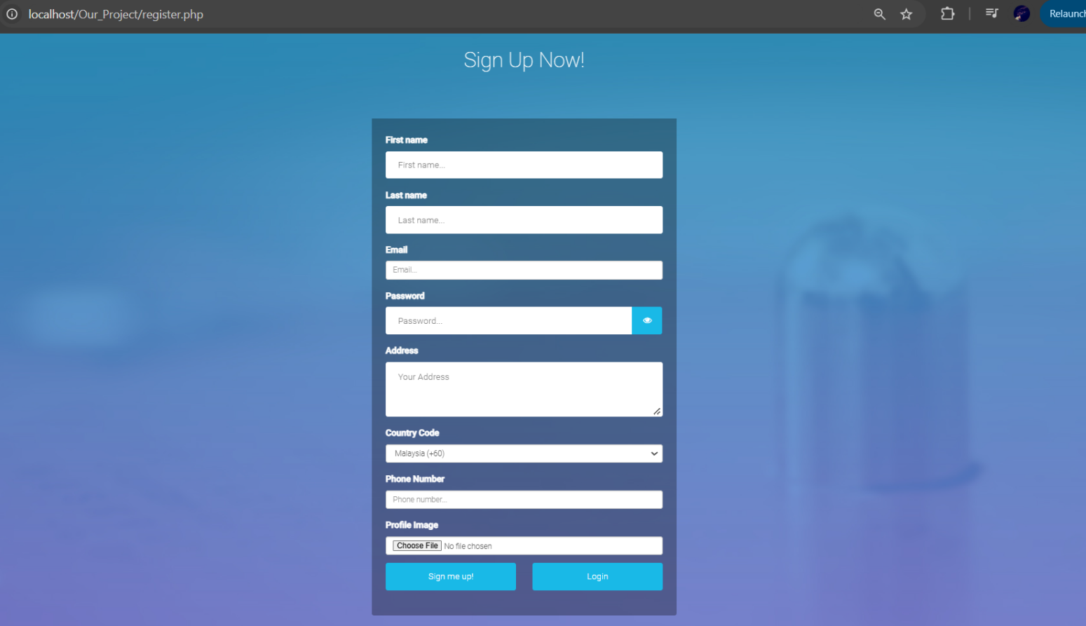
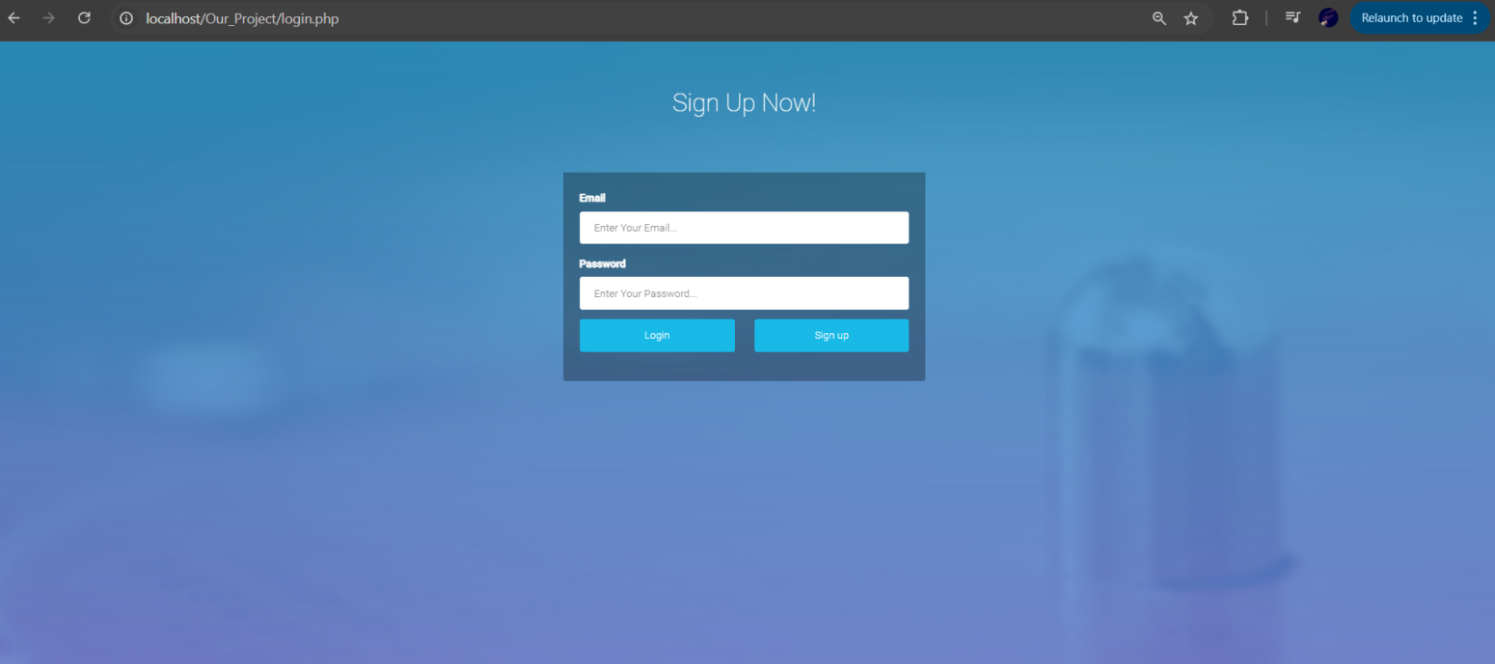
Core Features
User registration and login: Users register with First name, Last name, email, password(encrypted), address, phone number and profile image, then it stored to ensure information security when logging in.

Slide 17
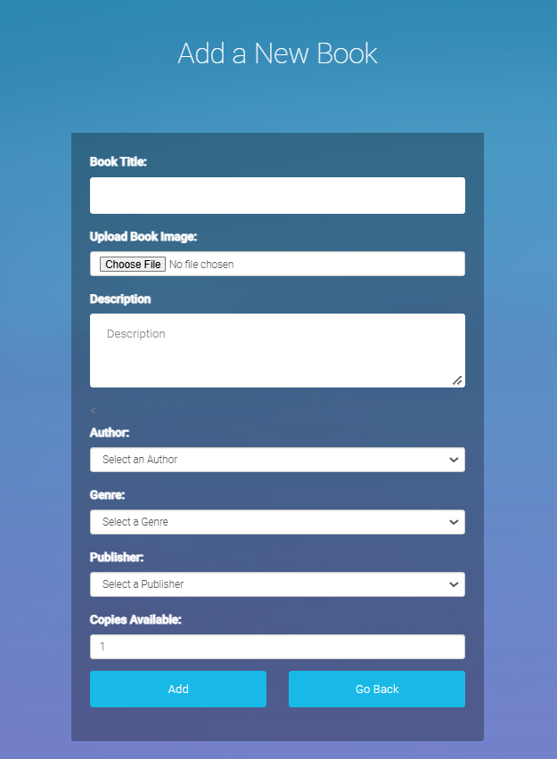
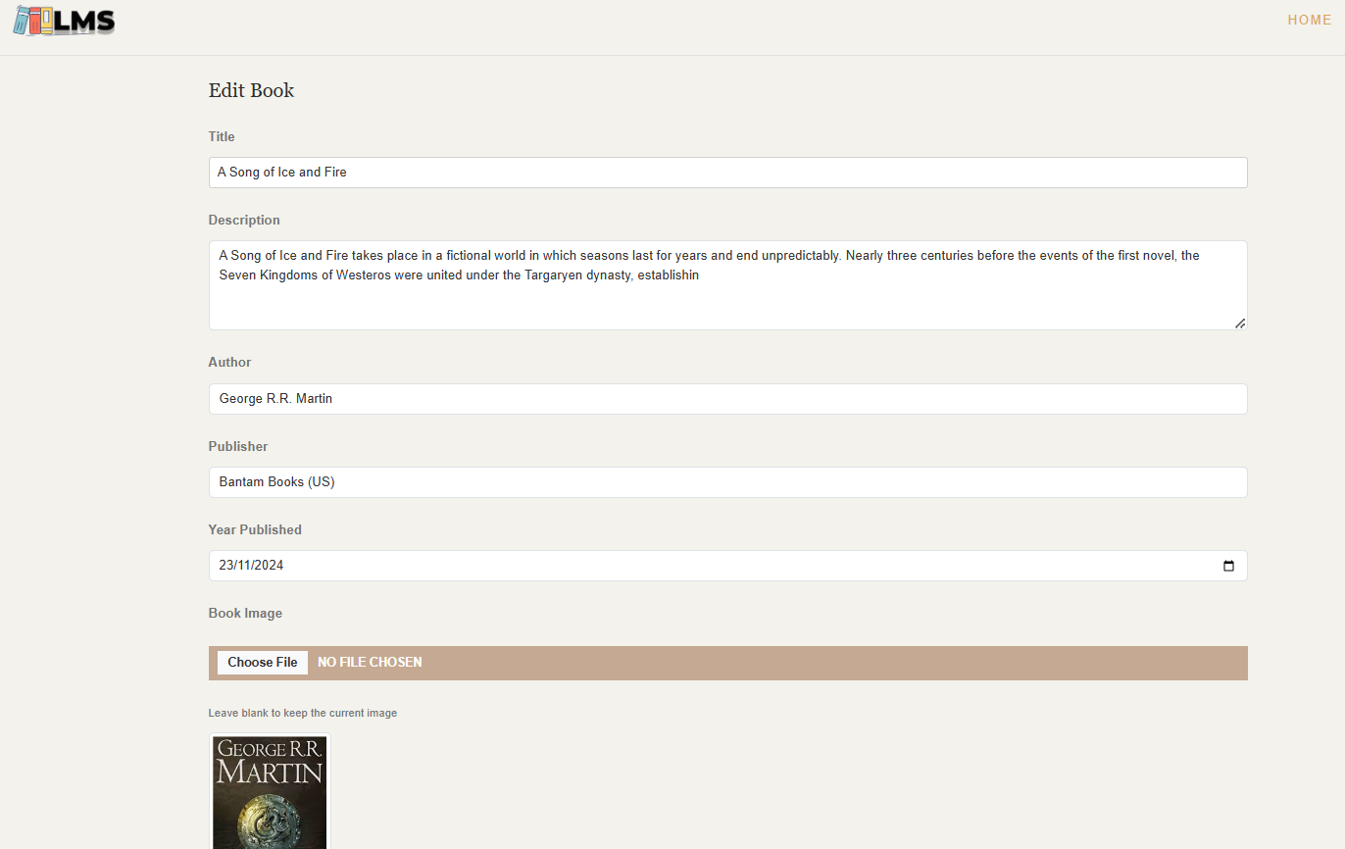

Core Features
Add, edit, or delete books records

Slide 18
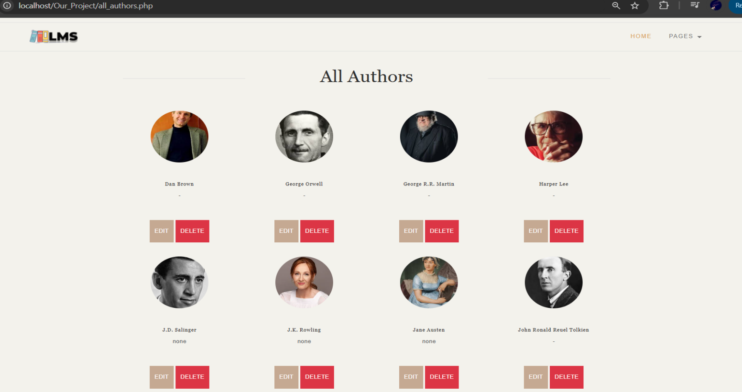
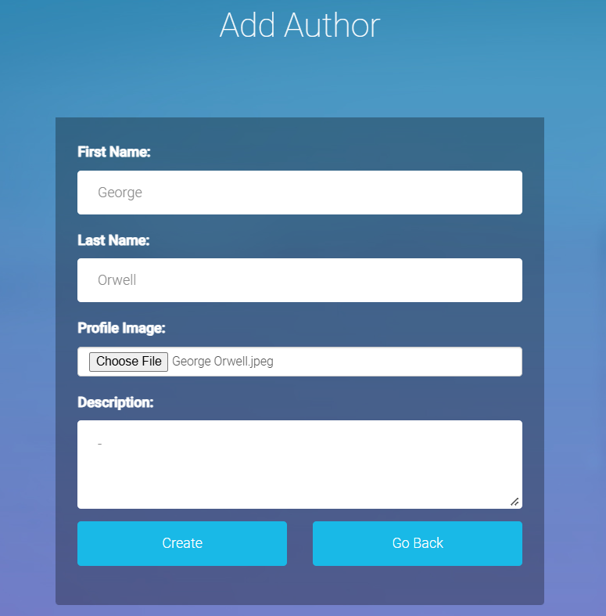
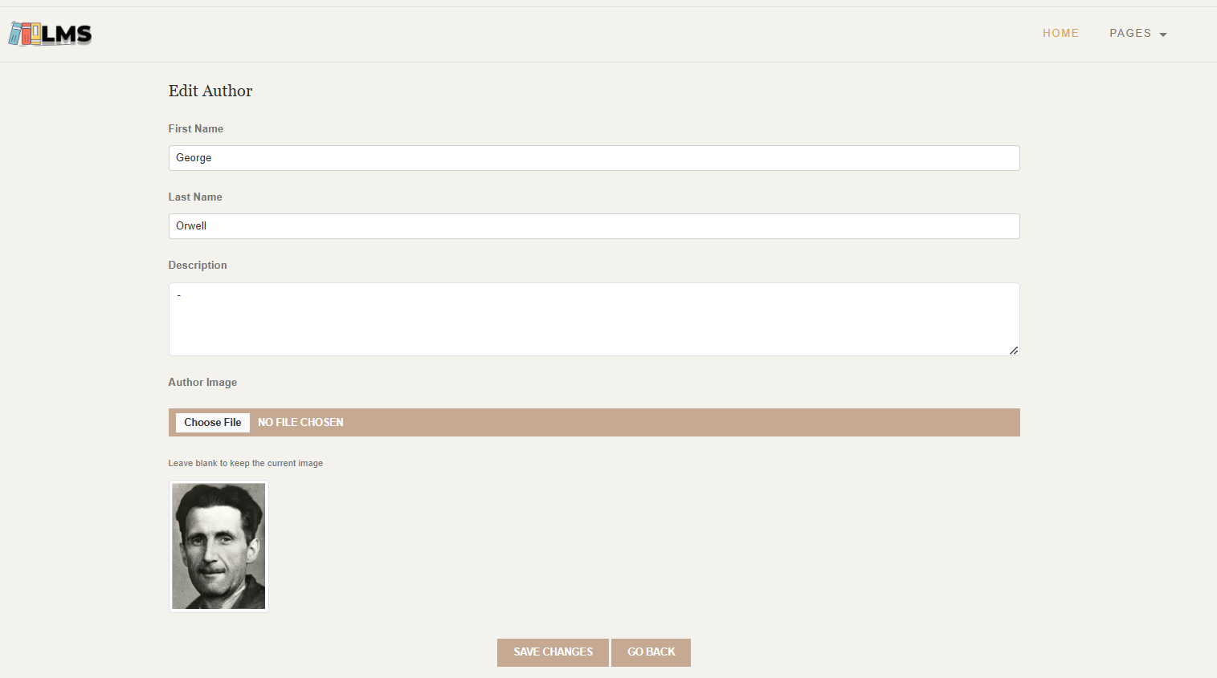
Core Features
Add, edit, or delete authors records

Slide 19
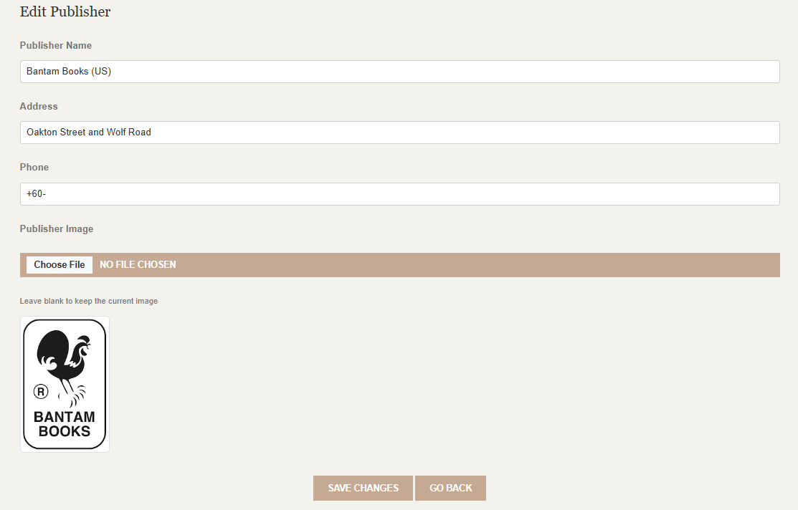
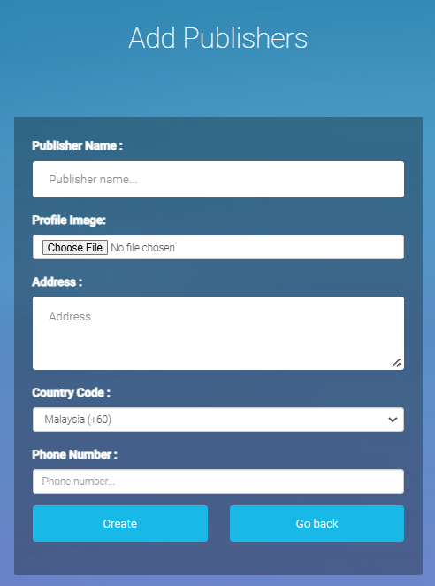
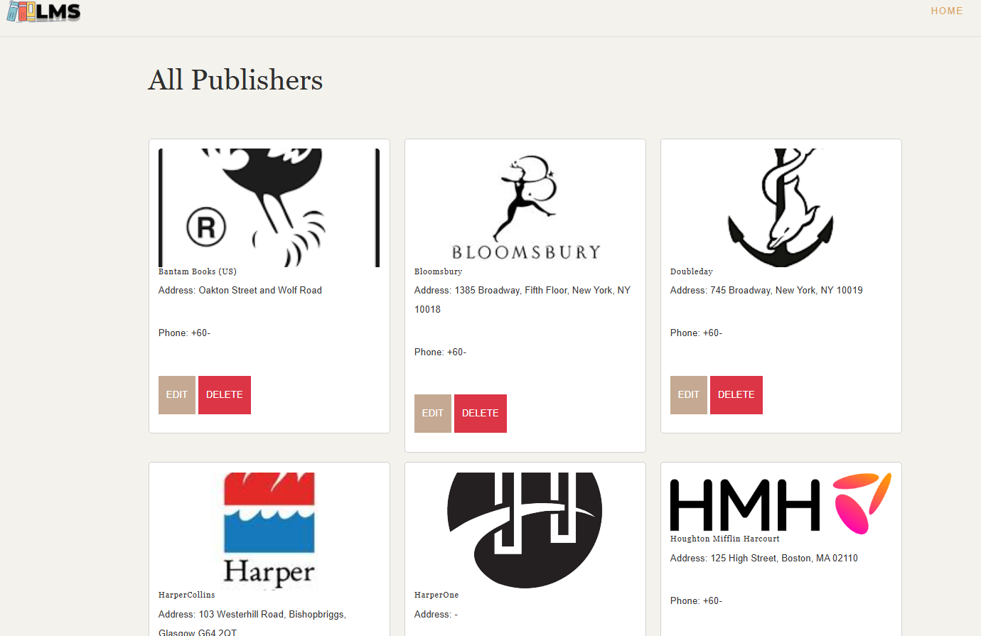
Core Features
Add, edit, or delete publishers records

Slide 20
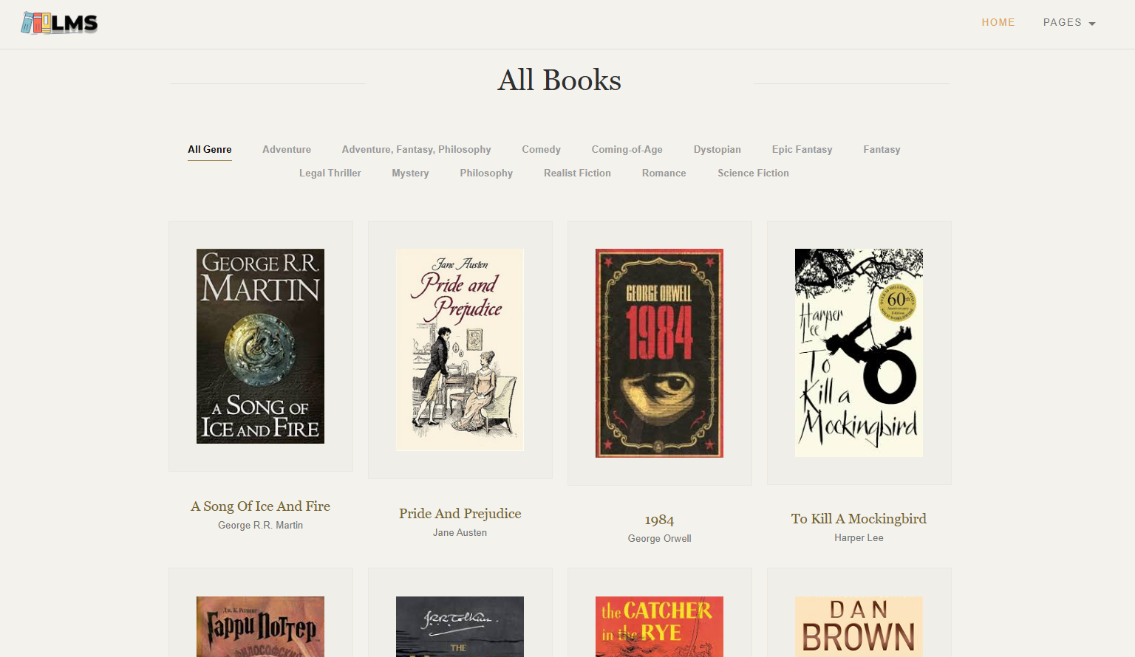
Core Features
Books list function: Users can view books information.

Slide 21
Testing and Quality Assurance

Slide 22
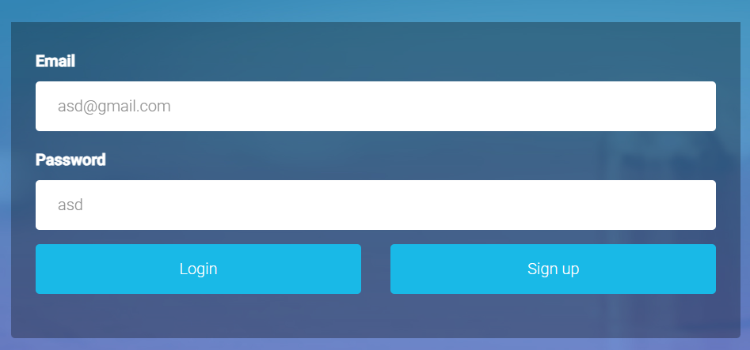
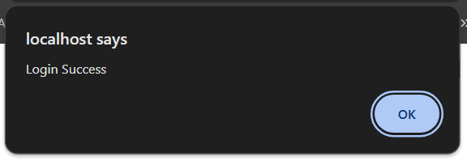
Unit Testing
Validation of Core Functional Modules to Ensure Reliable Functionality
•Test Scenario: Verify user login functionality.
Steps:
Open the login page.
Enter valid credentials (e.g., Email and Password).
Click the "Login" button.
Expected Result:
User is redirected to the dashboard or homepage with a success message (e.g., "Login success").
Actual Result:
Pass. Works as expected.

Slide 23
Performance Testing
Approach
•Conducted load testing to simulate multiple users accessing the system simultaneously.
•Tools Used: Apache JMeter, Locust.
Results
Login Page:
• Simulated Load: 100 users in 10 seconds.
• Response Time: Average of 1.2 seconds.
• Optimization: Reduced server-side queries by adding caching for session data.
Book Addition Functionality:
•Simulated Load: 50 simultaneous submissions of the "Add Book" form within 1 minute.
•Response Time: Average response time of 1.8 seconds.
•Optimization: Optimized database insert queries and reduced validation overhead in the PHP script.

Slide 24
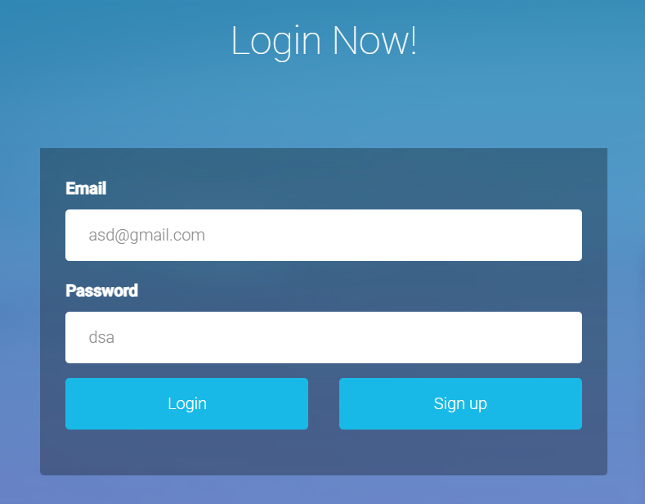
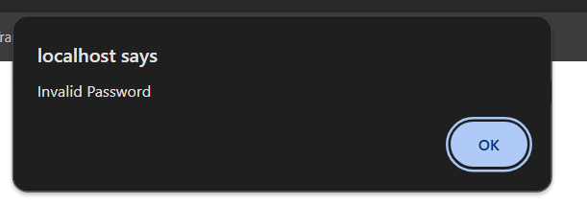
Security Testing
Test Scenario: Validate user login and access control.
Steps:
Attempt login with incorrect credentials (wrong password or email).
Expected Result:
Users can log in only with valid credentials.
Admin features are accessible only by users with admin roles.

Slide 25
Deployment and Optimization

Slide 26
Deployment Process
I. Development Preparation:
v Ensure all files are organized and properly structured.
v Test the application locally to confirm functionality.
II. Database Setup:
v Export the local database using phpMyAdmin.
v Import the database to the live server using the hosting provider’s phpMyAdmin interface.
III. File Transfer:
v Use GitHub or the hosting provider’s file manager to upload all project files to the /public_html directory.
v Update database connection settings in the PHP configuration file to reflect the live server’s database credentials.

Slide 27
Optimization Techniques
Code Optimization:
v Minimized redundant PHP code and reused functions to improve maintainability.
v Optimized SQL queries by adding indexes to frequently searched fields.
Caching:
v Implemented server-side caching for session data and database queries to reduce load times.
Asset Optimization:
v Minimized CSS and JavaScript files using online tools (e.g., CSS Minifier, JS Compress).
v Enabled Gzip compression on the server for faster file transfers.

Slide 28
Challenges and Lessons Learned

Slide 29
Challenges
1. Technical Difficulties
v Integration Issues:
Merging the frontend and backend components initially caused discrepancies due to mismatched API response formats and inconsistent endpoint naming.
v Database Optimization:
Inefficient queries led to slower response times, especially for search and filtering functionalities with large datasets.
v Deployment Challenges:
Deploying the application to the live environment encountered firewall and configuration issues, leading to downtime during the deployment process.
2. Time Management Issues
v Unrealistic Estimates:
Some tasks, such as database schema design and UI testing, took longer than anticipated, affecting the overall timeline.
v Conflicting Schedules:
Coordinating among team members with varying academic and personal schedules posed difficulties in setting consistent work sessions.

Slide 30
Lesson Learned
Lessons Learned
1. Collaboration and Communication
Shared Knowledge Base:
Maintaining centralized documentation, such as API references and design guidelines, significantly improved collaboration and efficiency.
Frequent Check-ins:
Regular daily stand-ups kept everyone aligned and allowed quick identification of blockers.
2. Technical Insights
Performance Optimization:
Early focus on database design and efficient query writing reduces downstream performance issues.
Testing:
Comprehensive and continuous testing, including unit tests and integration tests, is essential for maintaining application stability and performance.

Slide 31
Conclusion and Future Work

Slide 32
Project Outcomes Summary
Final Deliverable
The project successfully delivered a fully functional Library Management System (LMS) with the following capabilities:
User Management: Secure login, registration, and role-based access (students, staff, administrators).
Book Management: Features for adding, editing, deleting, and categorizing books.
Borrowing: Automated transaction tracking, with real-time updates to book inventory.

Slide 33
Future Optimization Directions
v Mobile Application:
Develop a dedicated mobile app for iOS and Android to reach a broader audience and improve accessibility.
v Advanced Analytics Dashboard:
Introduce detailed insights for librarians, such as reading trends, most borrowed books, and user activity heatmaps.
v Digital Library:
Enable e-book borrowing and integration with digital content providers for users to read books online.
v Multilingual Support:
Add support for multiple languages to cater to a diverse user base.

Slide 34
Final Thoughts
The project has been a rewarding journey, resulting in a practical and user-friendly application that addresses the primary needs of a library system. Through effective collaboration, the team overcame technical and time-related challenges to deliver a robust solution.
The lessons learned and the foundation laid in this project will serve as a stepping stone for future developments, enabling us to build even more feature-rich and scalable applications.
The team takes pride in the accomplishments and looks forward to expanding the system’s capabilities in the future, ensuring it continues to meet the evolving needs of its users.

Slide 35
Thank You

